Slide 1




GitHub Copilot for Developers
Tim Warner
Principal Author, Pluralsight
timw.info | azureopenai.blog

Slide 2
Break Schedule (Central time)
09:00 AM - Start – Segment 1 [Foundations & Core Workflow]
10:00 AM - 10 min break – Segment 2 [Chat Power Features]
11:00 AM - 10 min break – Segment 3 [Agentic Features]
12:00 PM - 10 min break – Segment 4 [Enterprise Features]
01:00 PM - Finish

Slide 3
Session Materials
timw.info/copilot-dev

Slide 4
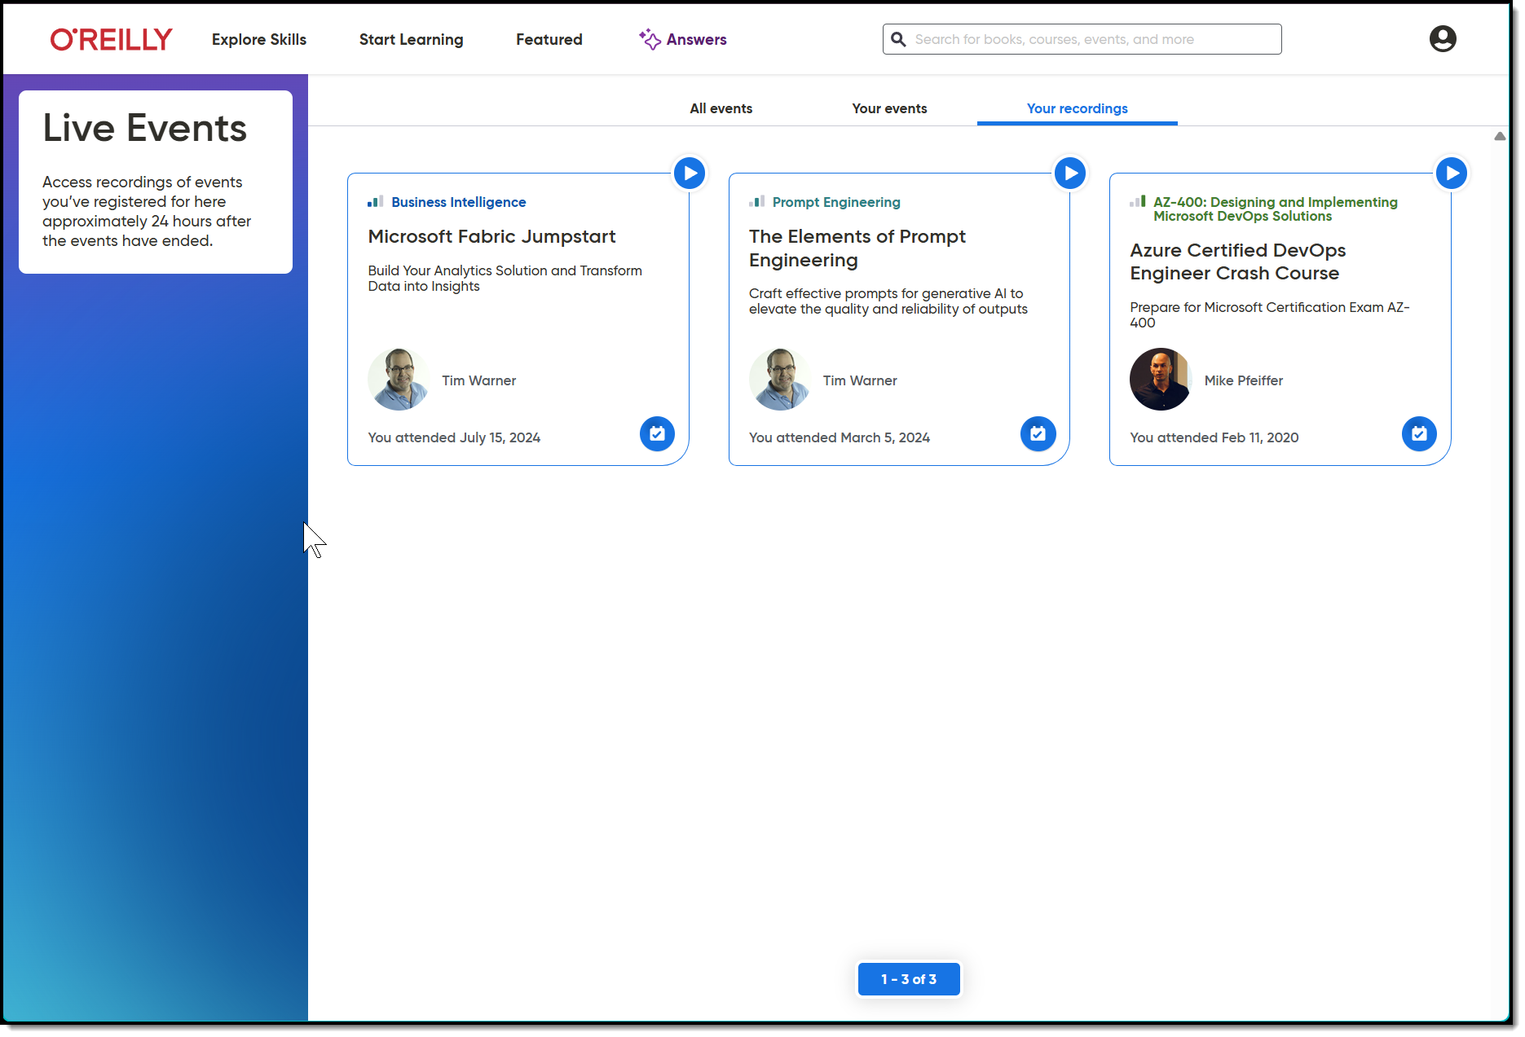
Session Recording + Badge

Slide 5
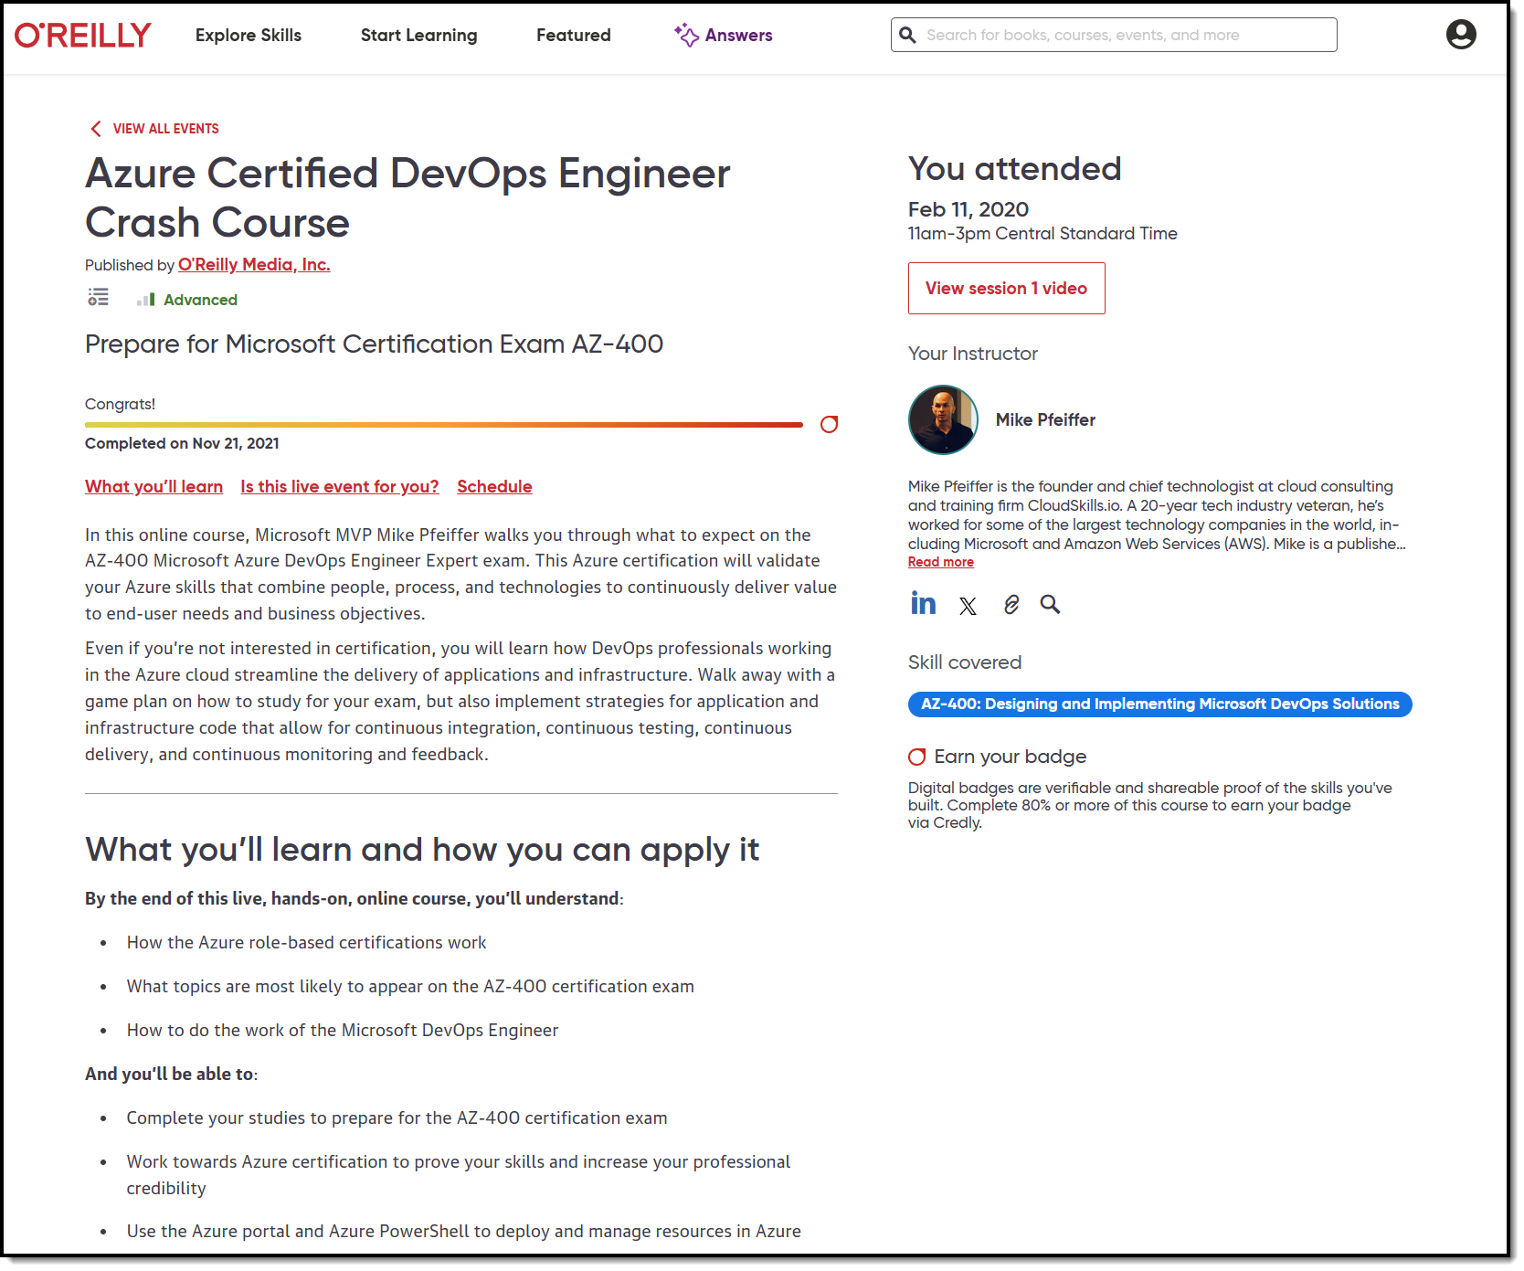
Session Recording + Badge

Slide 6
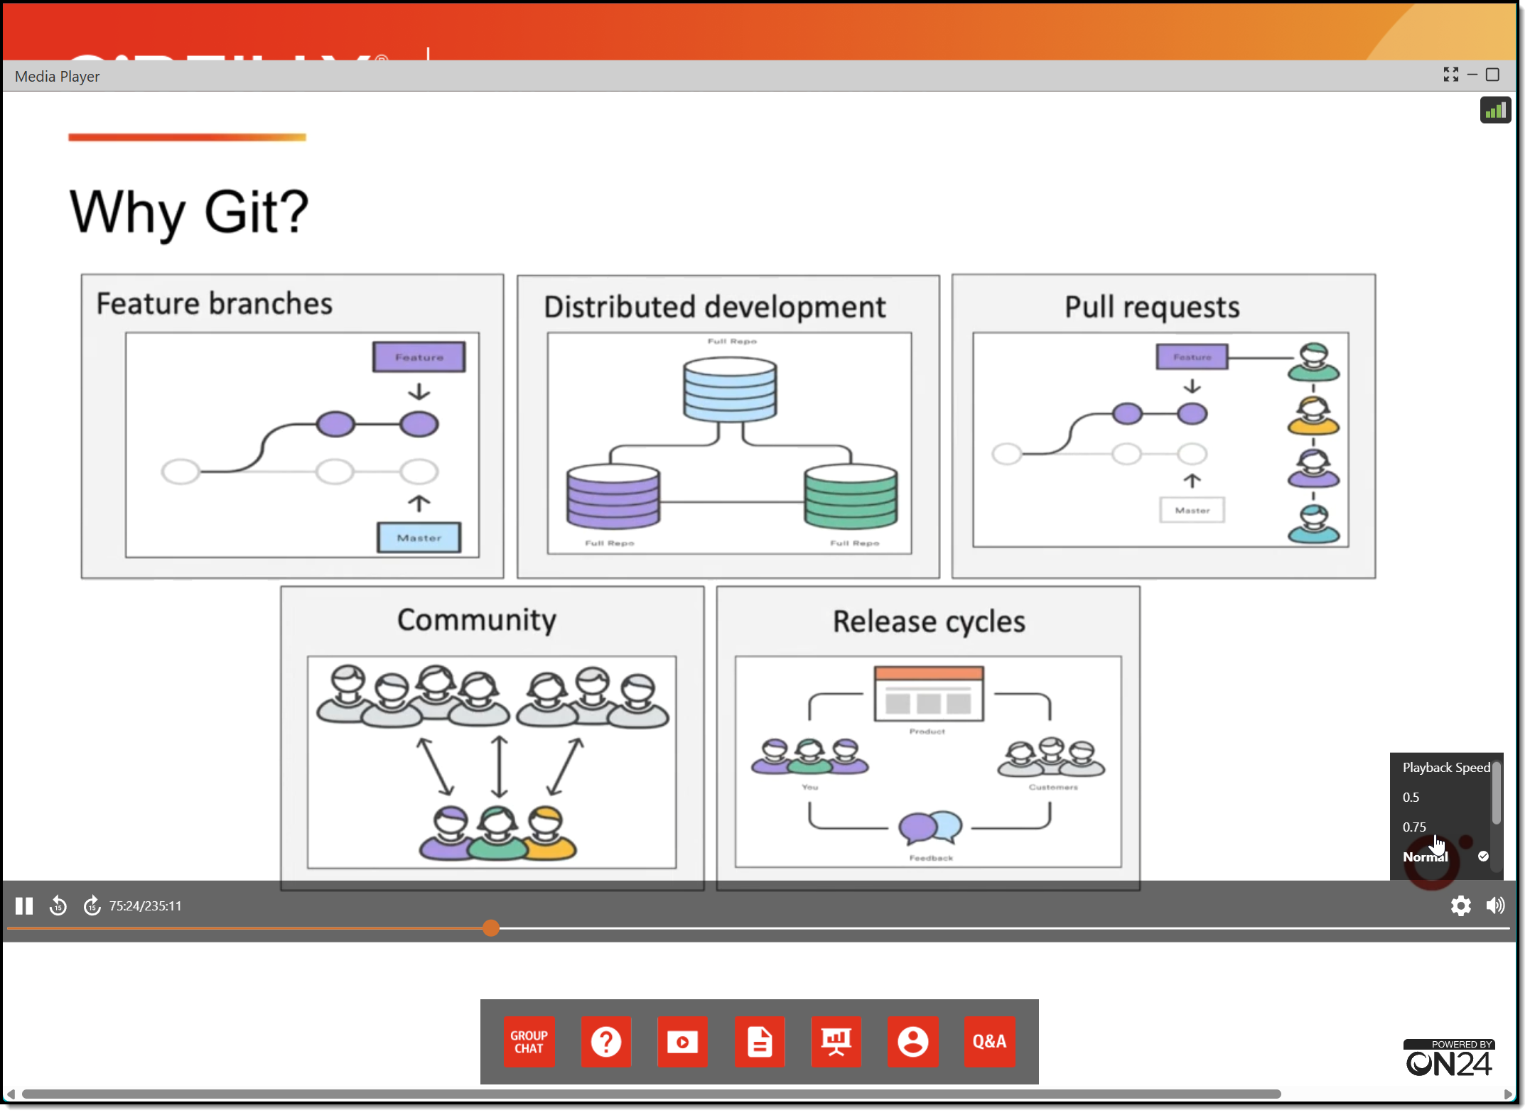
Session Recording + Badge

Slide 7
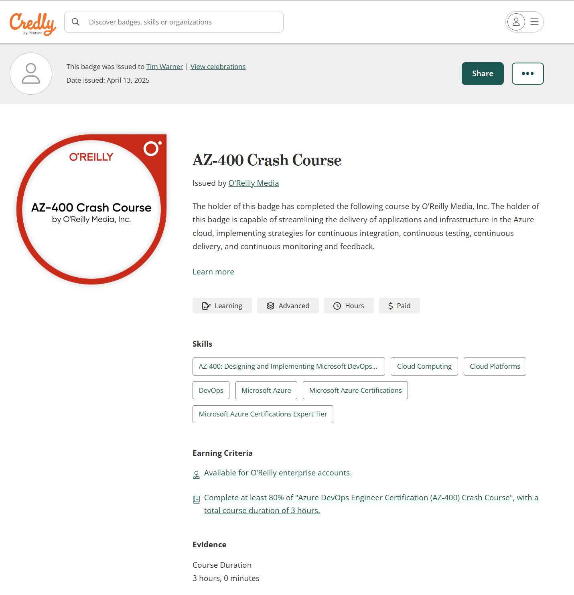
Session Recording + Badge

Slide 8
Let’s Get to Work!

Slide 9



Keeping an LLM on task be like…

Slide 10
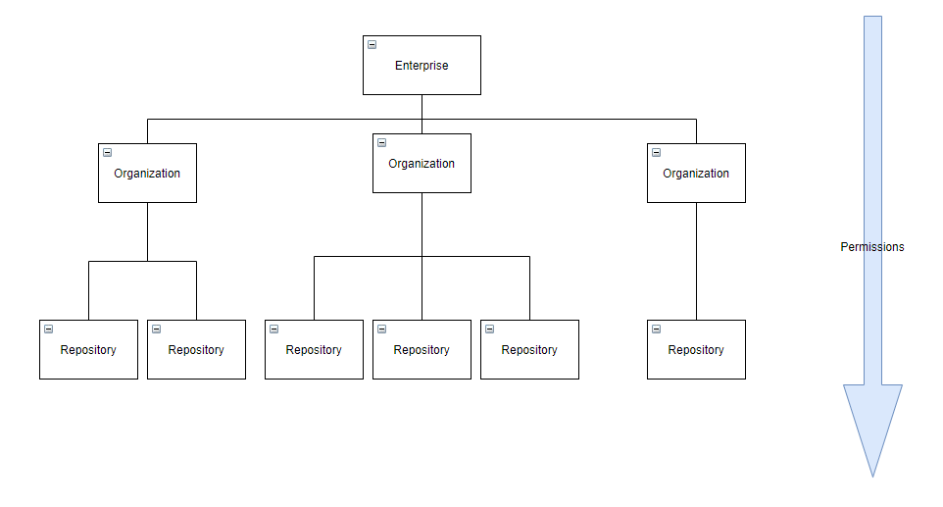
GitHub Enterprise Cloud (GHEC)
Reference: https://github.com/dduzgun-security/github-enterprise-cloud-configuration

Slide 11
Custom Instructions Scopes
Repo: .github/copilot-instructions.md
Workspace: .github/instructions/*.instructions.md
YAML directive
---
applyTo: "src/**/*.js"
---
Org: In GitHub web UI
MCP: Agent mode gear icon

Slide 12
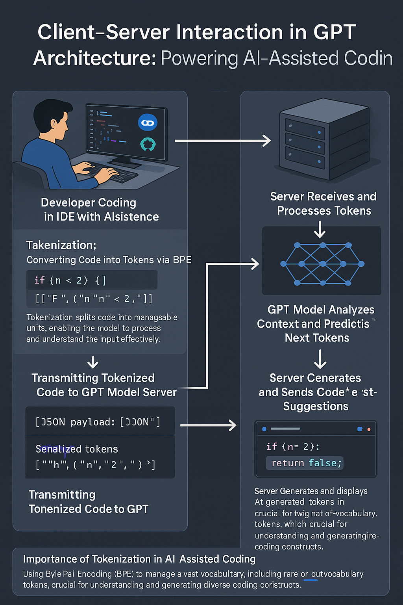
GPT Basic Architecture
OpenAI GPT 4o Image Generation
Multimodal generative AI
Two ways to improve model:
Fine tuning
Retrieval Augmented Generation (RAG)

Slide 13

Neural Network
go.techtrainertim.com/cloud

Slide 14

Context Length

Slide 15
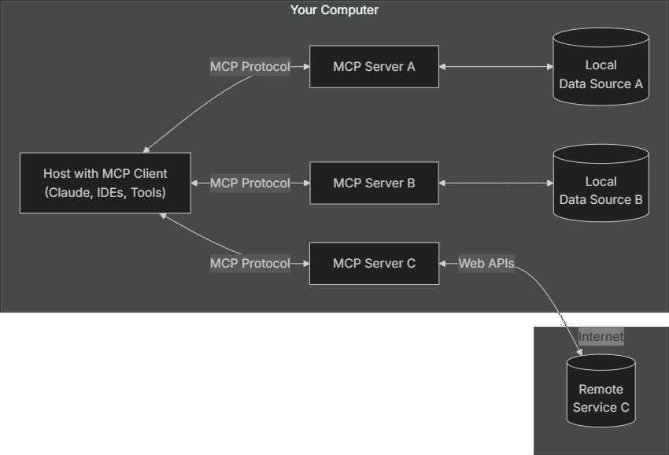
Model Context Protocol (MCP) by Anthropic
modelcontextprotocol.io

Slide 16
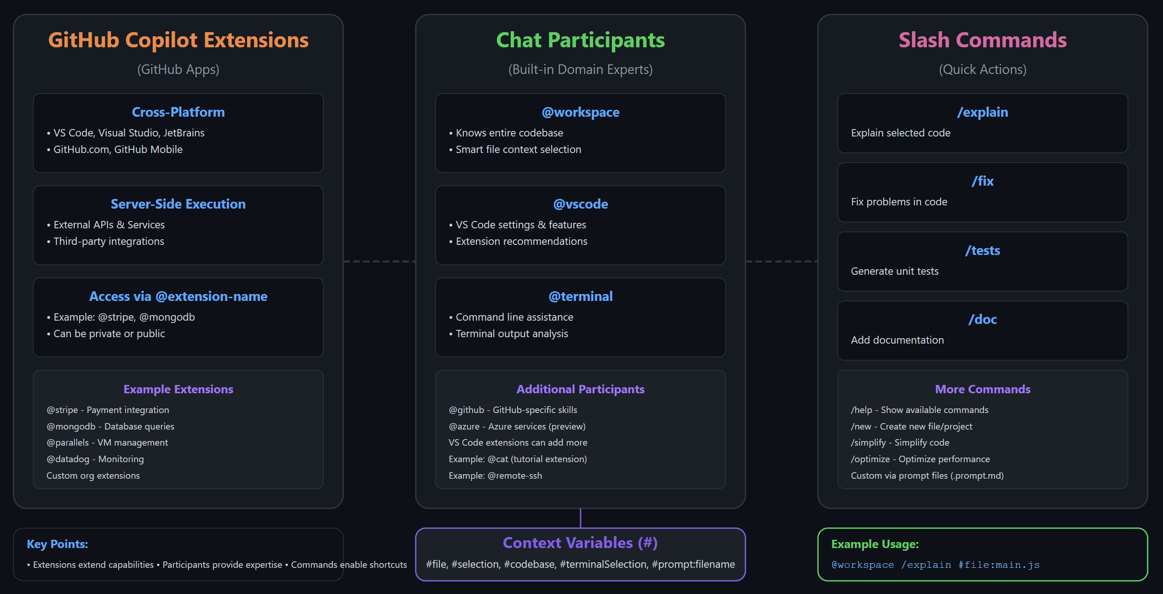
Extending GitHub Copilot

Slide 17

Thank you!
Course materials: timw.info/copilot-dev
Contact: TechTrainerTim.com

